Slide 1
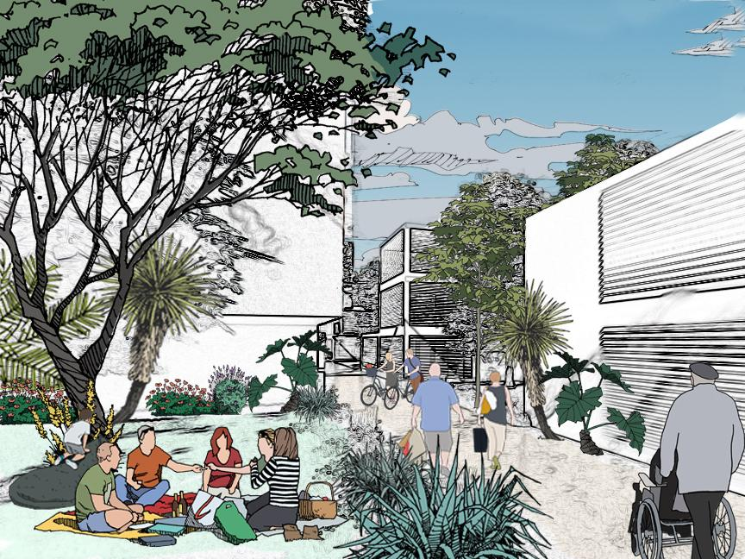
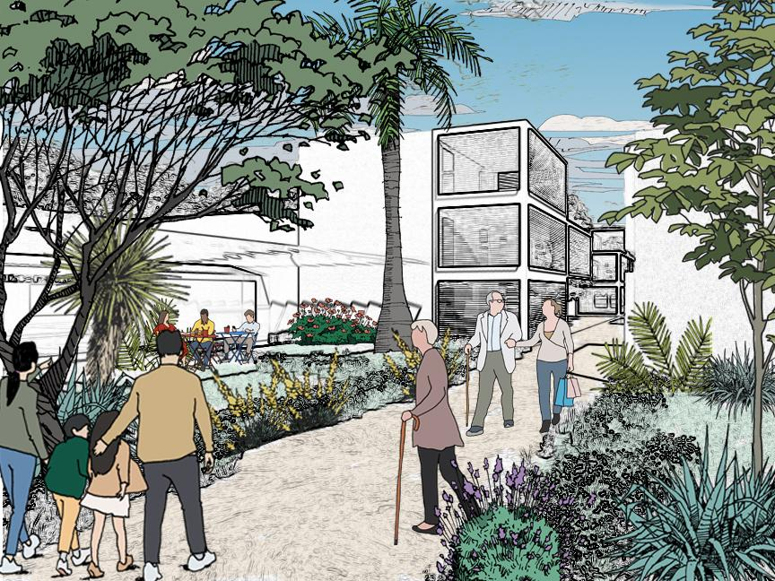
2021 ASHRAE LowDown Showdown Modeling Competition
2021 Building Performance
Analysis Conference
The Planeteers
2021 ASHRAE LowDown Showdown Modeling Competition

Slide 2
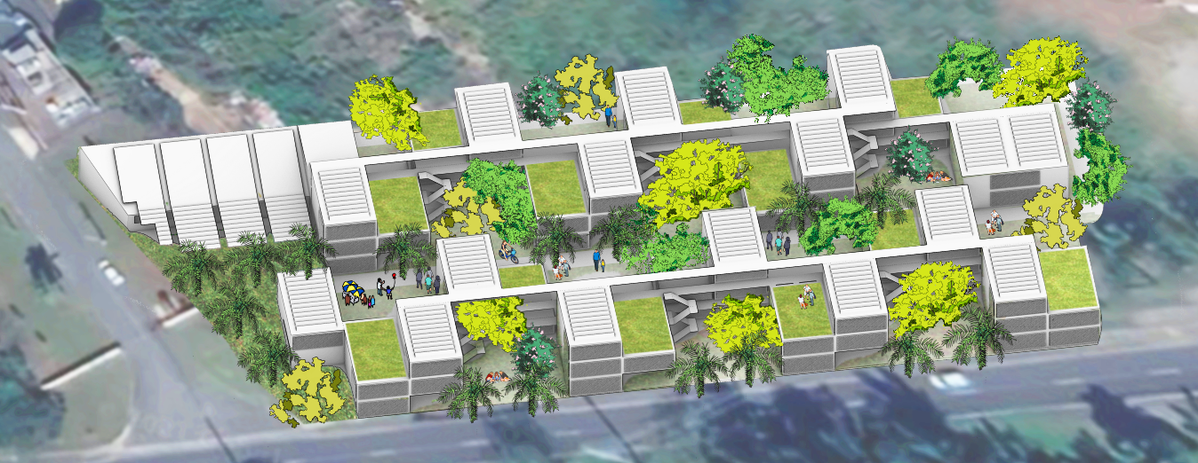
Operating Cost -$53,271
Site EUI 20.7 kBtu/ft²
CUI(2030) 4.7 kg CO₂e/ft²
Payback Period 5 years
Source EUI -13.4 kBtu/ft²
CUI(2050) -10.2 kg CO₂e/ft²
2021 ASHRAE LowDown Showdown Modeling Competition

Slide 3
Project Goals
GOAL 1 Develop an assisted living community that integrates with and strengthens the community at large.
GOAL 2 Maximize the use of passive design strategies to increase the thermal, visual, and air quality experience of the space
GOAL 3 Limit or eliminate active cooling systems and complicated environmental controls
GOAL 4
Use of next-generation materials to develop replicable low-maintenance, resilient solutions
GOAL 5 Minimize the carbon footprint for the development from both the construction and operational side
2021 ASHRAE LowDown Showdown Modeling Competition
Project Goals
Minimize the carbon footprint for the development both from the construction and operational side
Maximize the use of passive design strategies to increase the thermal, visual, and air quality experience of the space
Use of next-generation materials to develop low-maintenance, resilient solutions
Use of landscape and building articulation to engage with the community at large

Slide 4
Local Context
2021 ASHRAE LowDown Showdown Modeling Competition

Slide 5
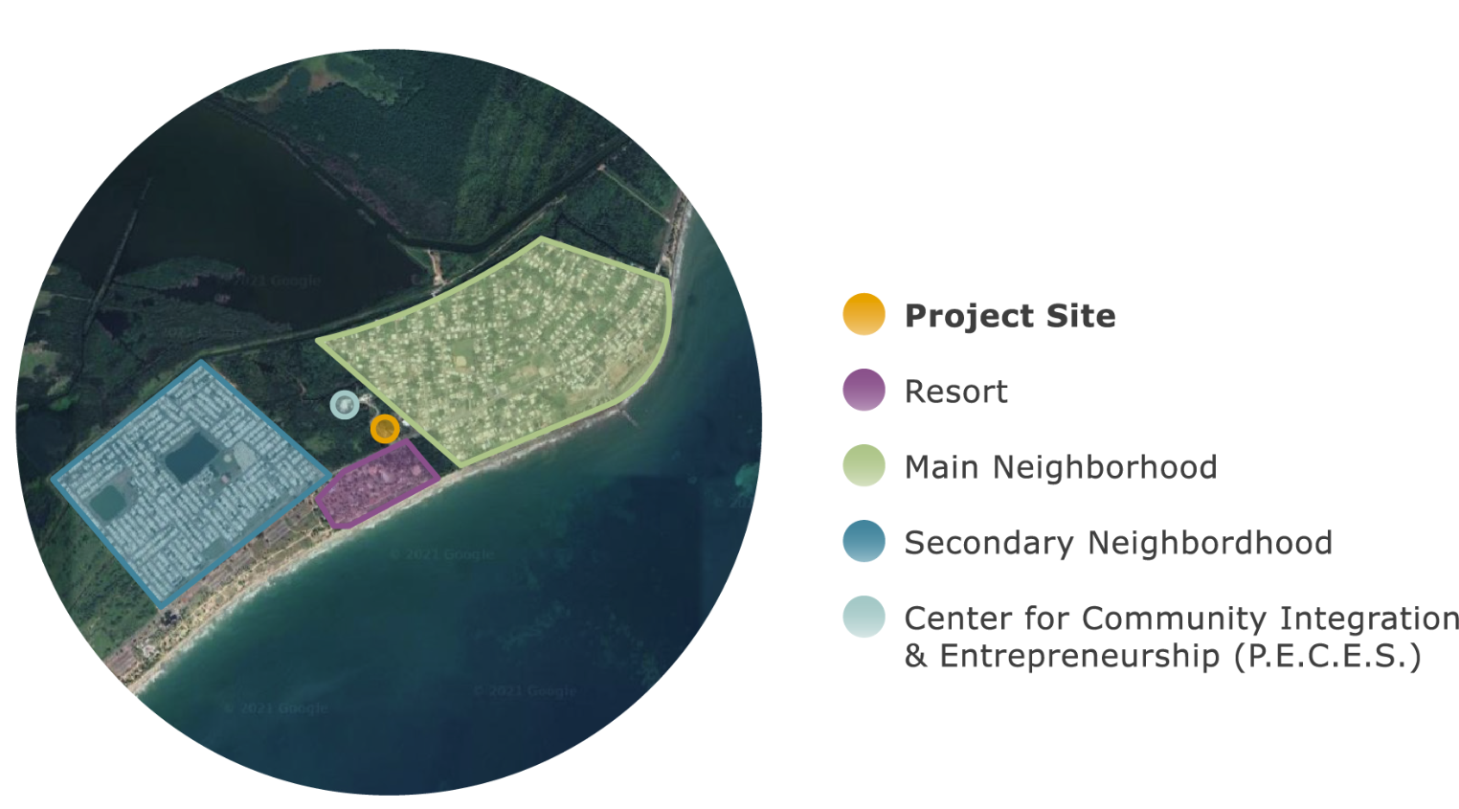
Town of Punta Santiago
2021 ASHRAE LowDown Showdown Modeling Competition

Slide 6
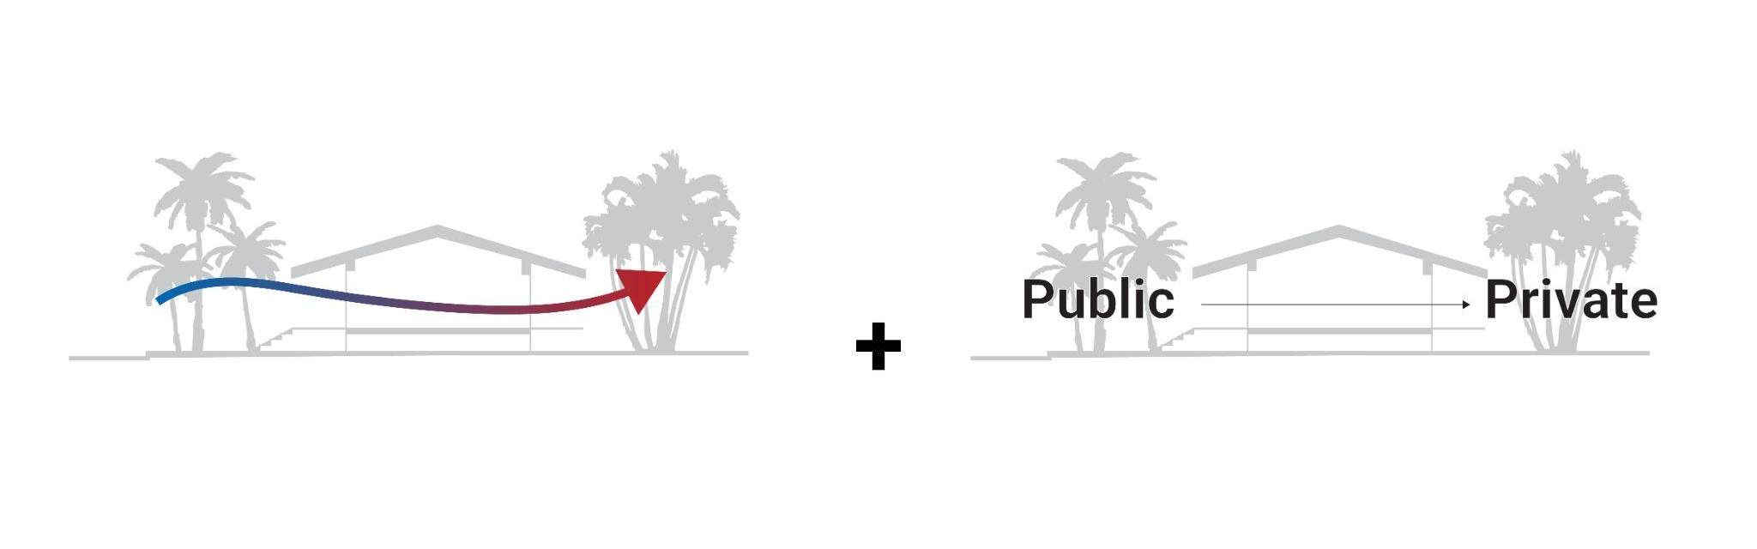
Learning from the Vernacular
Raised Massing, Shading, and Breezeways
Public/Private Dimensions in Traditional Housing
2021 ASHRAE LowDown Showdown Modeling Competition

Slide 7
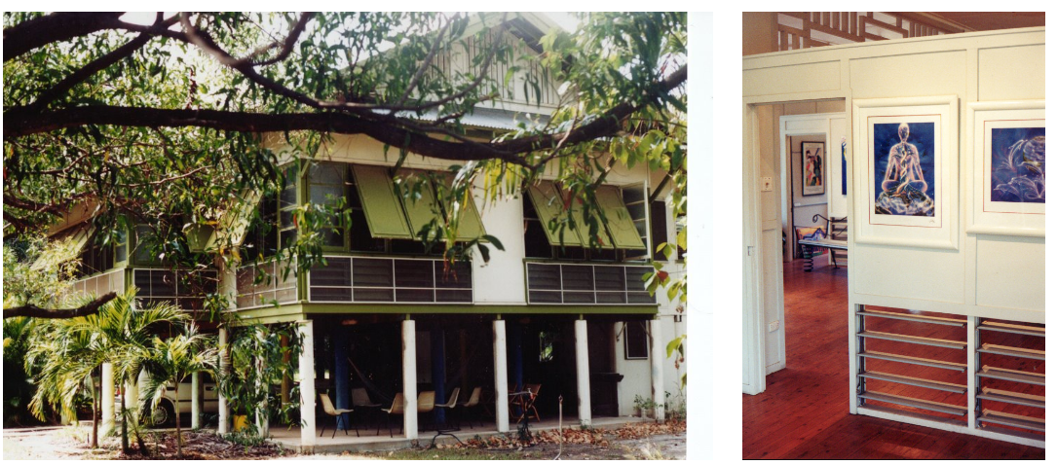
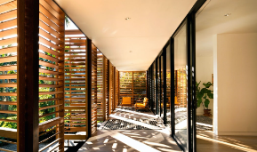
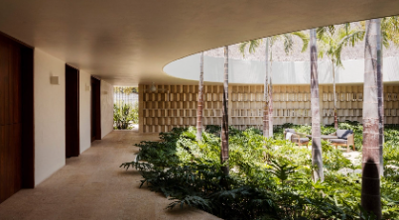
Climate Responsive Design - Inspirations
2021 ASHRAE LowDown Showdown Modeling Competition

Slide 8
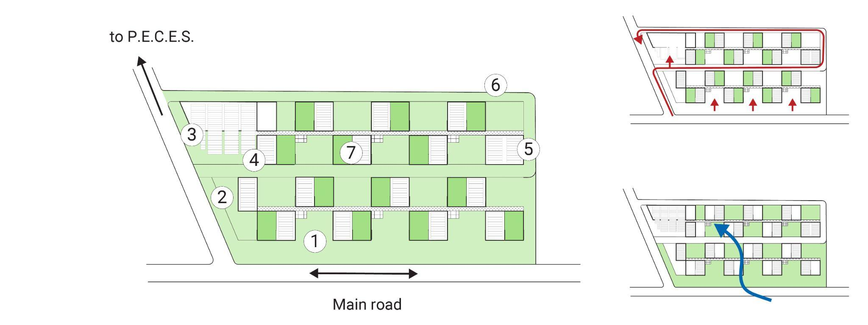
Community Engagement
to Community Center (P.E.C.E.S.)
Entrance Sequence
Main Road
Prevailing Wind
1. Gardens inviting to community
2. Main entrance and Lobby
3. Dining and Kitchen
4. Offices
5. Clinic Facility
6. Slow Road
7. Typical Residence
2021 ASHRAE LowDown Showdown Modeling Competition

Slide 9
Open Space Network
to Community Center (P.E.C.E.S.)
Entrance Sequence
Main Road
1. Street facing gardens
2. Entry court garden
3. Community kitchen and dining
4. Neighborhood road
5. Residential gardens
6. Elevated semi-private terraces
7. Elevated walkways
2021 ASHRAE LowDown Showdown Modeling Competition

Slide 10
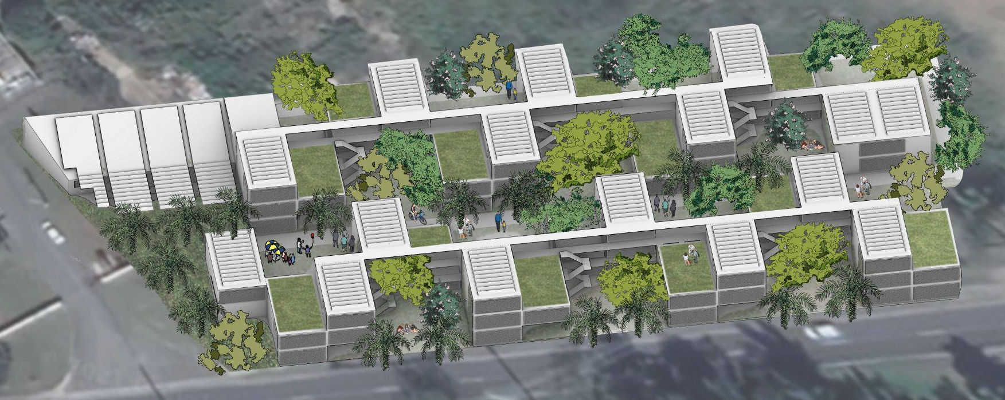
Community
2021 ASHRAE LowDown Showdown Modeling Competition

Slide 11
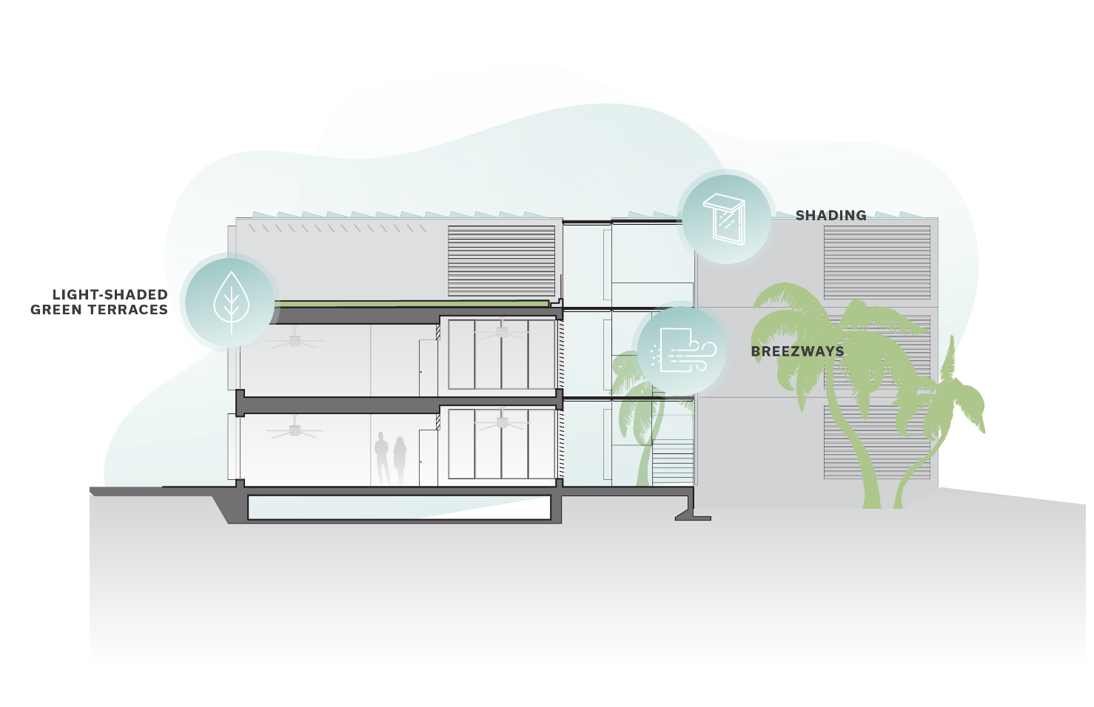
Architectural Passive Design
2021 ASHRAE LowDown Showdown Modeling Competition

Slide 12
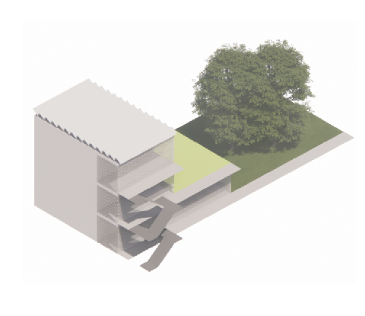
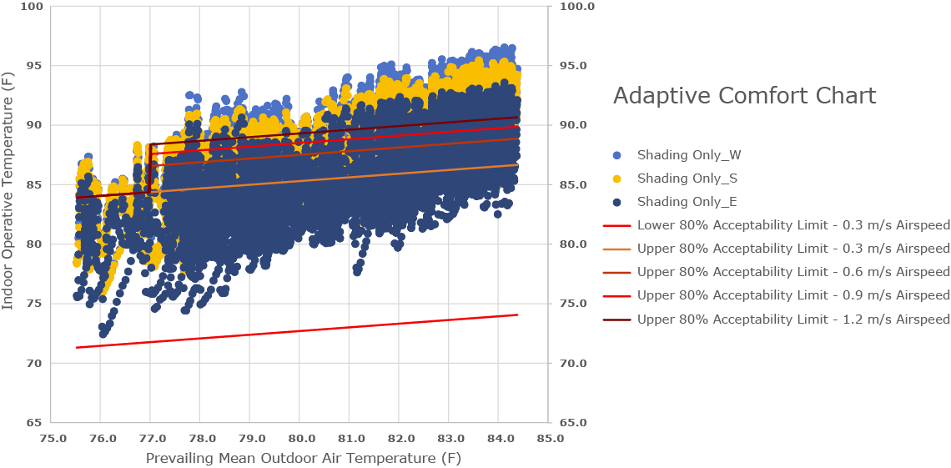
Passive Design Approach - Shading Only
Hygroscopic
shades
2021 ASHRAE LowDown Showdown Modeling Competition

Slide 13
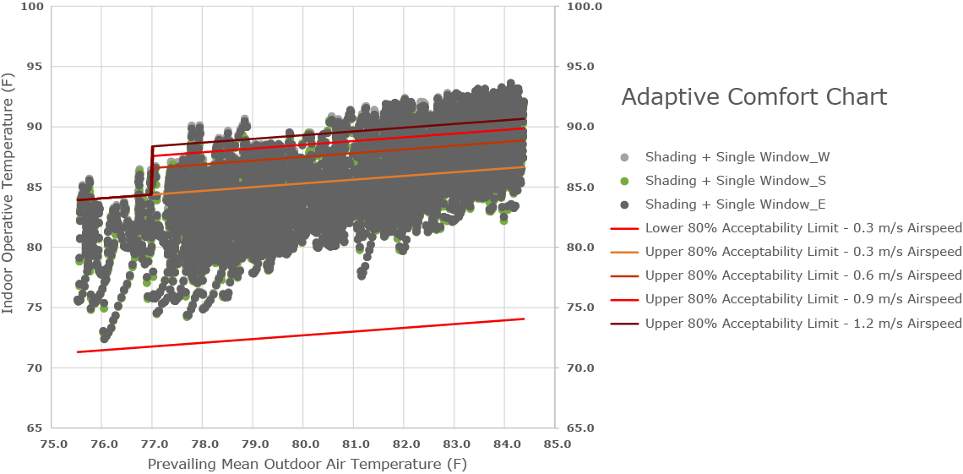
Passive Design Approach - Shading with Single Orientation Operable Windows
Operable windows
Hygroscopic
shades
2021 ASHRAE LowDown Showdown Modeling Competition

Slide 14
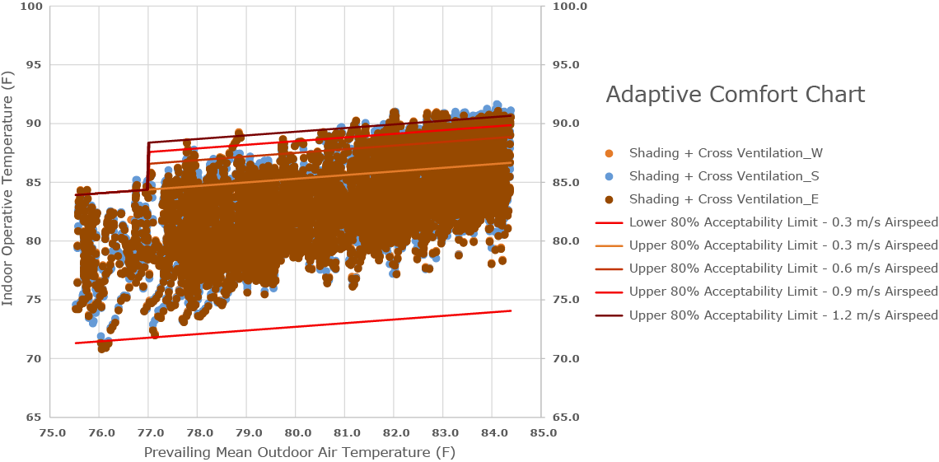
Passive Design Approach - Shading with Cross Ventilation
Cross ventilation
Hygroscopic
shades
2021 ASHRAE LowDown Showdown Modeling Competition

Slide 15
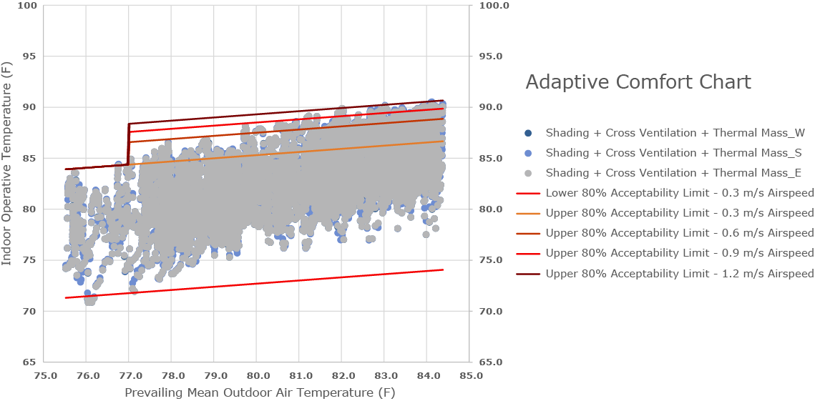
Passive Design Approach - Shading with Cross Ventilation and Decoupled Thermal Mass
Cross ventilation
Hygroscopic
shades
Decoupled thermal mass
2021 ASHRAE LowDown Showdown Modeling Competition

Slide 16
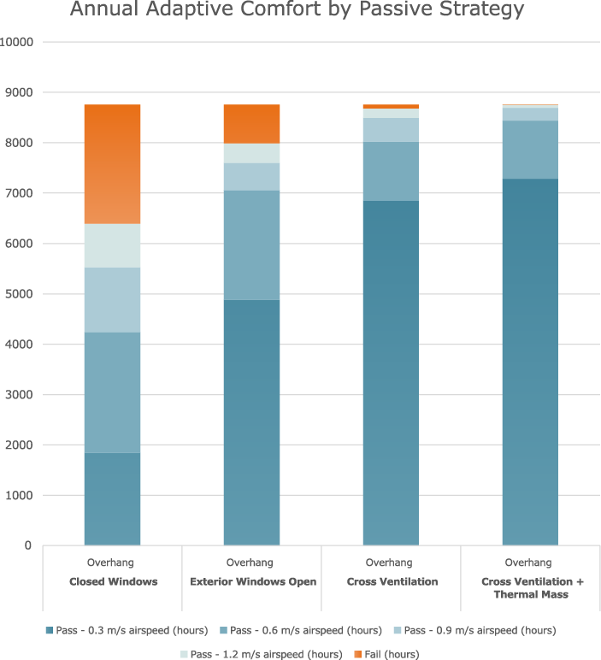
Passive Design Approach - Summary
Cross ventilation
Operable windows
Hygroscopic
shades
Decoupled thermal mass
2021 ASHRAE LowDown Showdown Modeling Competition

Slide 17
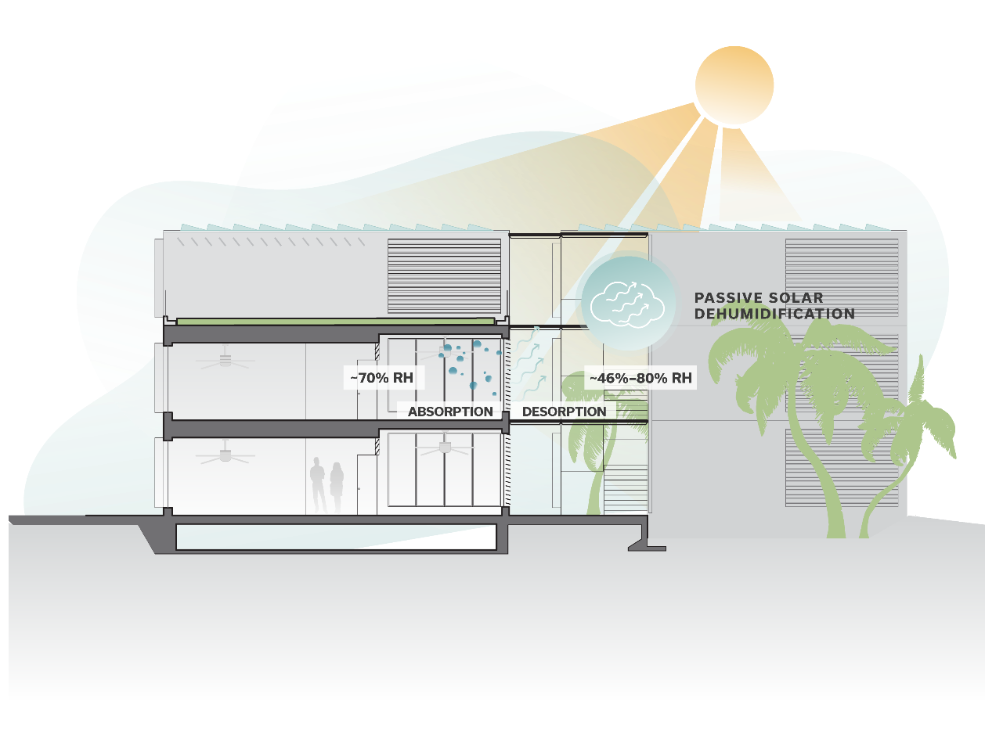
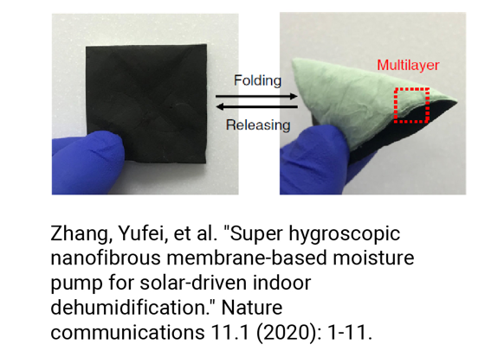
Innovation - Passive Solar Dehumidification
Moisture Pump
2021 ASHRAE LowDown Showdown Modeling Competition

Slide 18
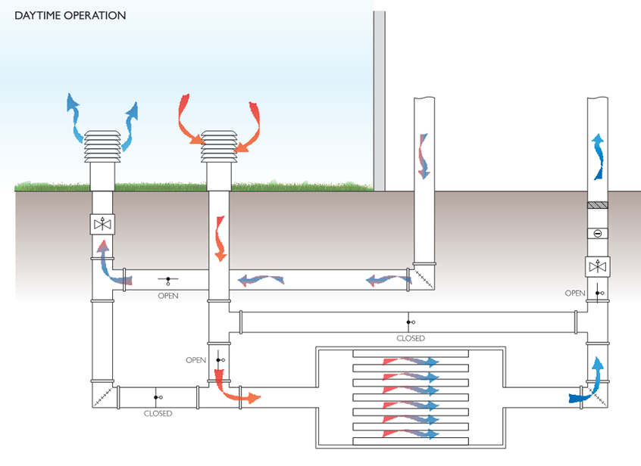
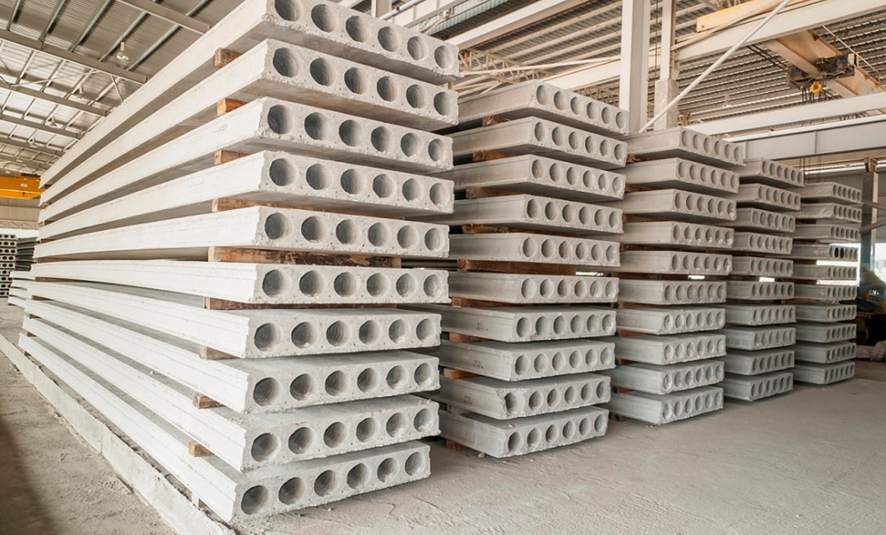
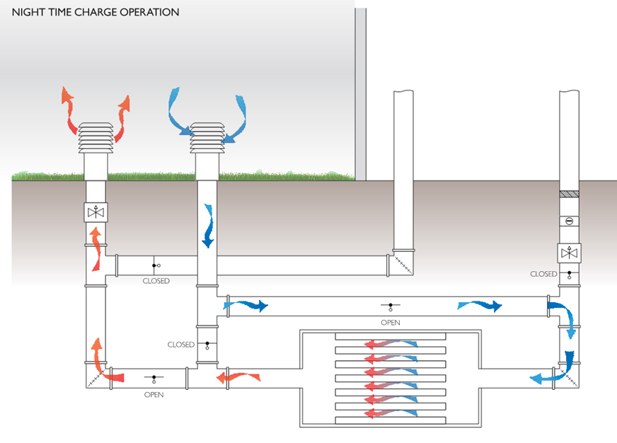
Innovation - Decoupled thermal mass
2021 ASHRAE LowDown Showdown Modeling Competition

Slide 19
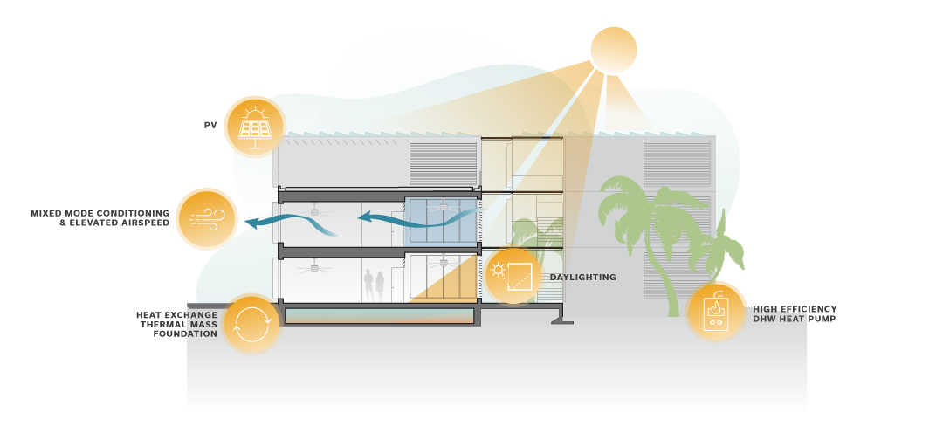
Energy Systems
2021 ASHRAE LowDown Showdown Modeling Competition

Slide 20
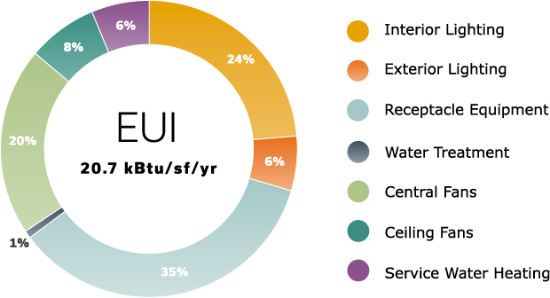
Operational Energy End-Use Breakdown
2021 ASHRAE LowDown Showdown Modeling Competition

Slide 21
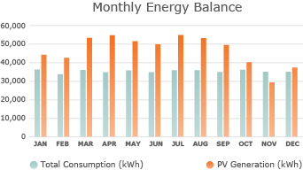
On-site Renewables
On-site Energy Storage
22% Efficiency
19,125 SF Covered
561,194 kWh production
500 kWh Battery Capacity
2021 ASHRAE LowDown Showdown Modeling Competition

Slide 22
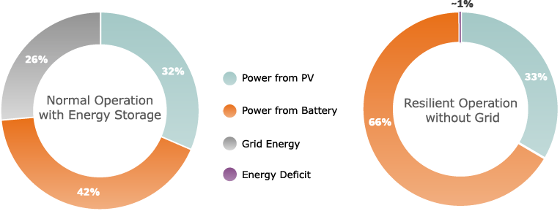
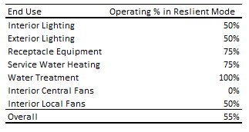
Resilience
Elevated first level and adjacent sunken gardens provide flood resilience
PV and energy storage provide capability for off grid operation during outage event
Rainwater storage and on-site water treatment provide freshwater resilience
Prefab modular design provides greater quality control of structure than traditional stick frame construction
2021 ASHRAE LowDown Showdown Modeling Competition

Slide 23
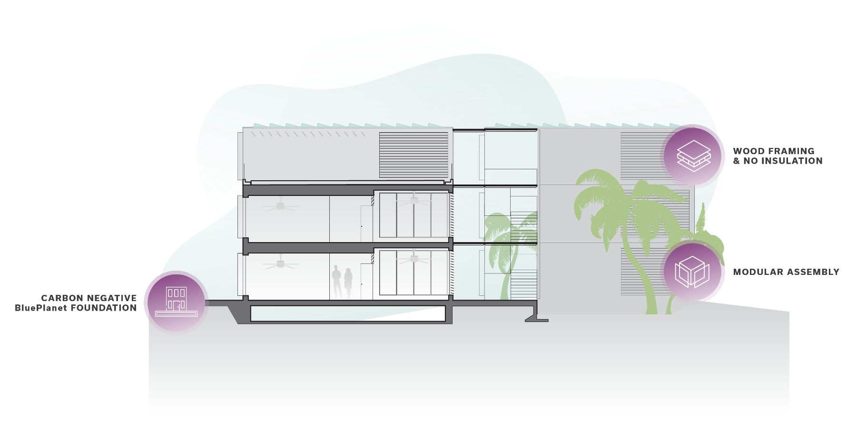
Materials & Construction
2021 ASHRAE LowDown Showdown Modeling Competition

Slide 24
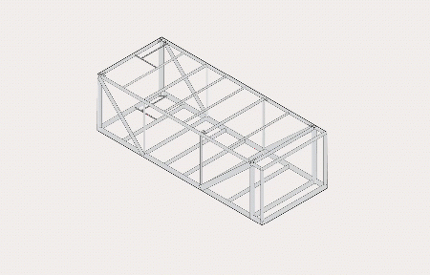
Innovation in Construction
PV Structure
Modular Dwelling Unit
Prefabricated Circulation
Unitized Foundation
(Decoupled Thermal Mass)
2021 ASHRAE LowDown Showdown Modeling Competition

Slide 25
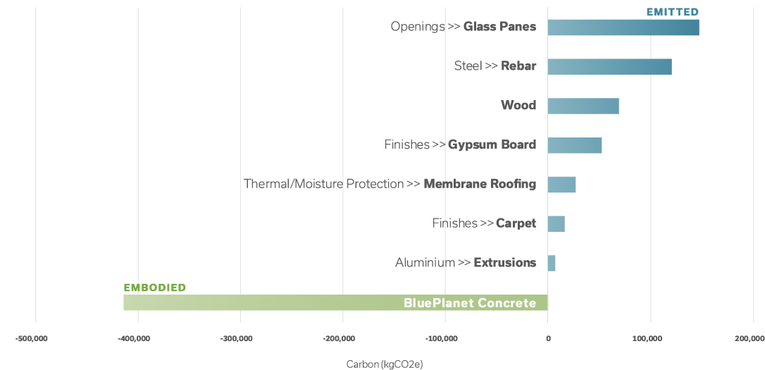
Realized Embodied Carbon by Material Category
2021 ASHRAE LowDown Showdown Modeling Competition

Slide 26
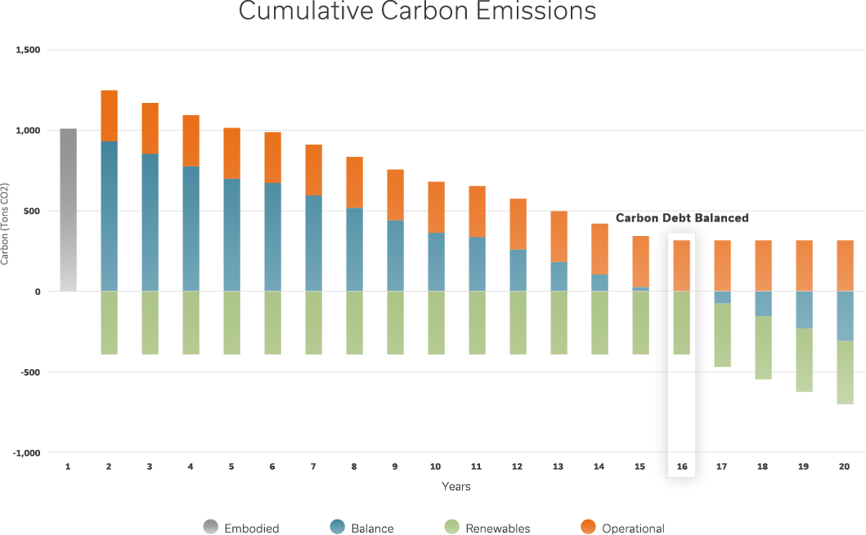
Cumulative Carbon Emissions
2021 ASHRAE LowDown Showdown Modeling Competition

Slide 27
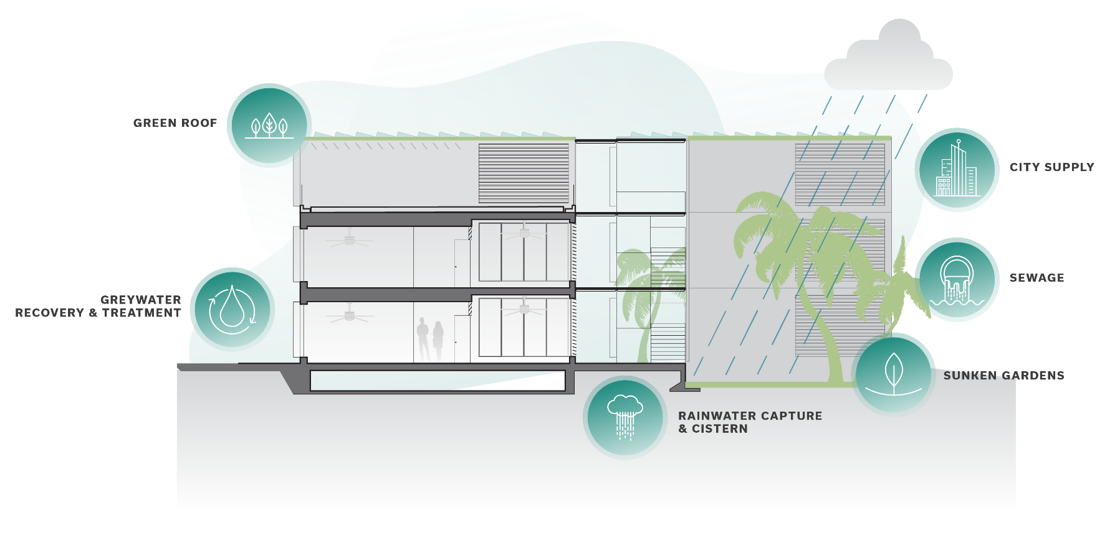
Water Balance
935,973 gal
1,332,716 gal
1,166,639 gal
771,242 gal/yr captured
69,444 gal cistern
2021 ASHRAE LowDown Showdown Modeling Competition

Slide 28
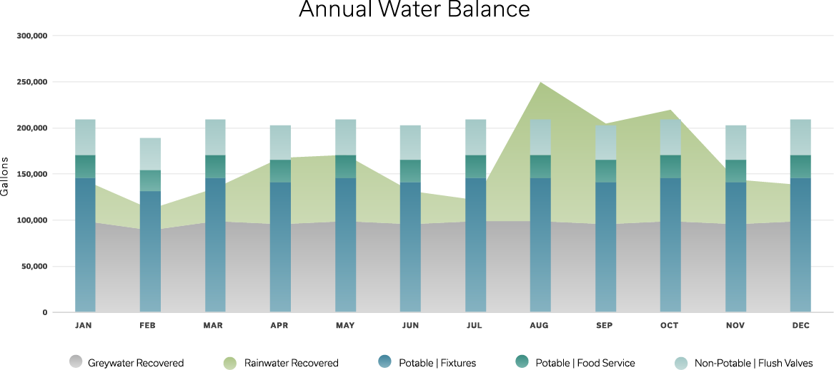
Annual Water Balance Results
2021 ASHRAE LowDown Showdown Modeling Competition

Slide 29
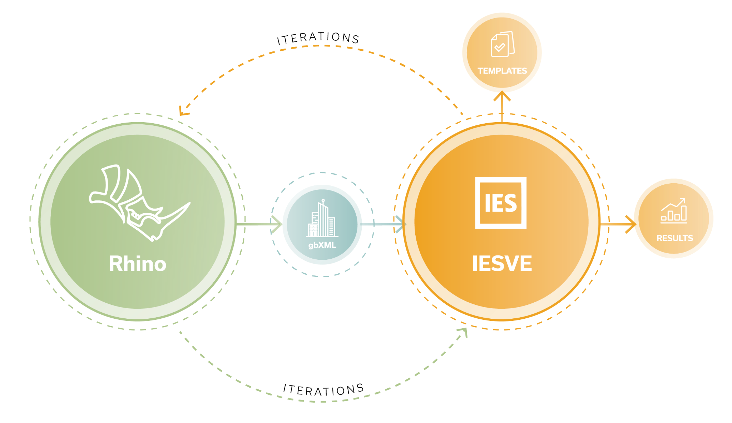
Modeling Practices
2021 ASHRAE LowDown Showdown Modeling Competition

Slide 30
Team Composition
Forest Tainer-Gesner Project Lead
Alan Shepherd Coach
Chris Sharples Principal
Annie Kwon Architect
Chrissa Turley Designer & Modeler
Kirsten Robinson Designer & Modeler
Jessie Li Designer
Berardo Matalucci Environmental Design
2021 ASHRAE LowDown Showdown Modeling Competition

Slide 31
Results Summary
 | IP | SI
Total Energy Use [kBtu - kWh] | 1,555,372 | 455,835
Total Water Use [gal - Liter] | 2,467,467 | 1,346
Total Onsite Production [kBtu - kWh] | 1,914,794 | 561,171
Total Energy & Water Cost [$] | -$53,271 | -$53,271
Total Site EUI [kBtu/ft² – kWh/m²] | 20.7 | 65
Total CUI 2030 [kg CO₂e/ft² – kg CO₂e/m²] | 4.4 | 47.4
Total CUI 2050 [kg CO₂e/ft² – kg CO₂e/m²] | -11.3 | -121.3
2021 ASHRAE LowDown Showdown Modeling Competition

Slide 32
Conclusions
Lessons Learned
Key Innovations
Future Studies
2021 ASHRAE LowDown Showdown Modeling Competition

Slide 33
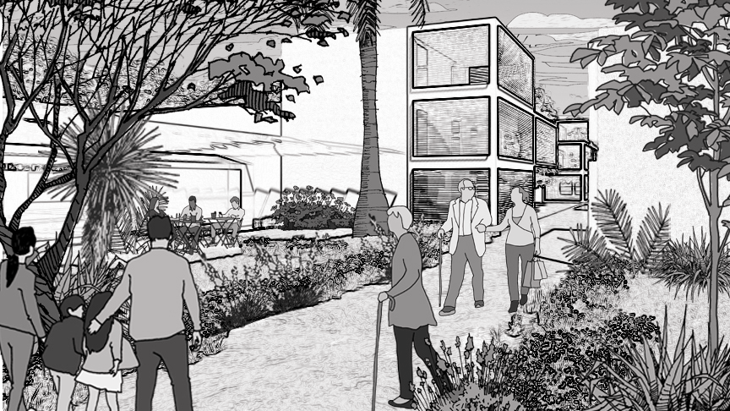
Thank You

